Slide 1

How to embed AI
when you have no AI skills

Slide 2












Thank you to our Sponsors!

Slide 3
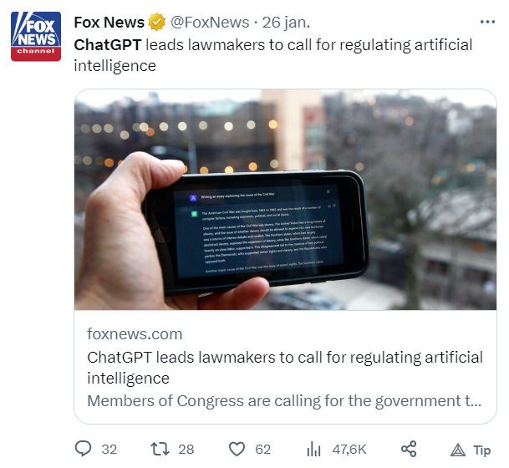
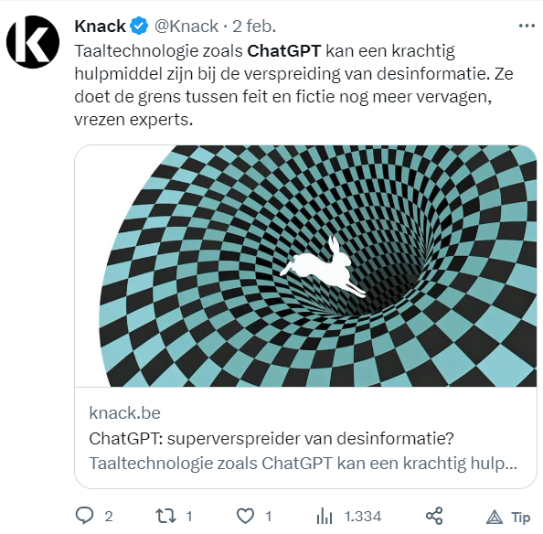
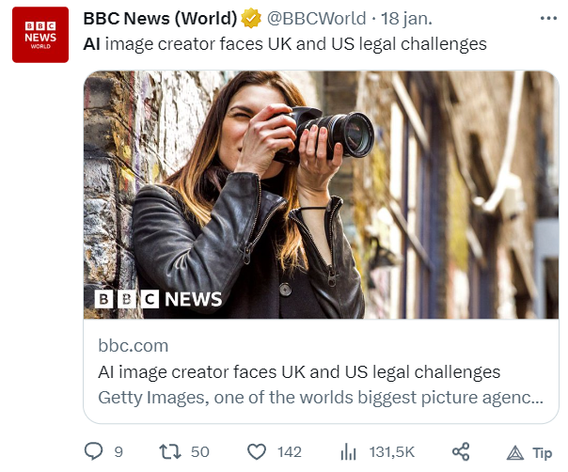
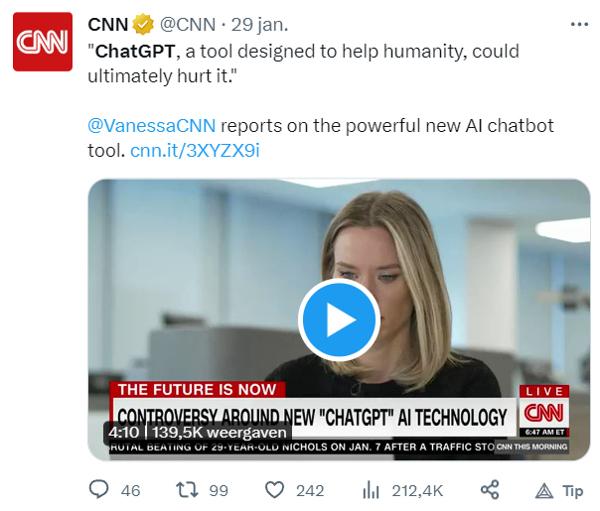

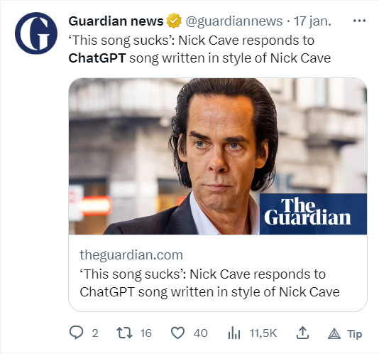
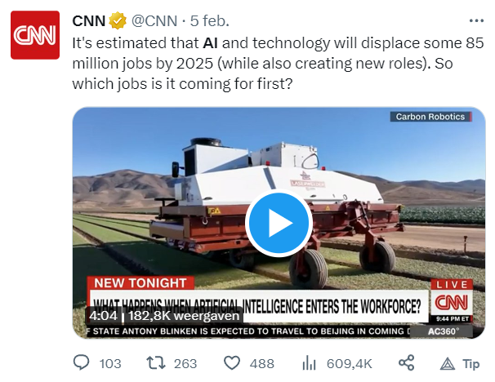
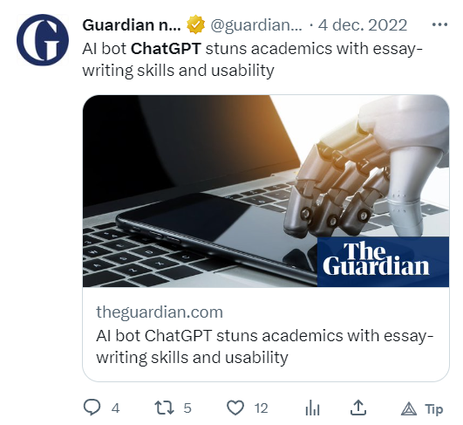
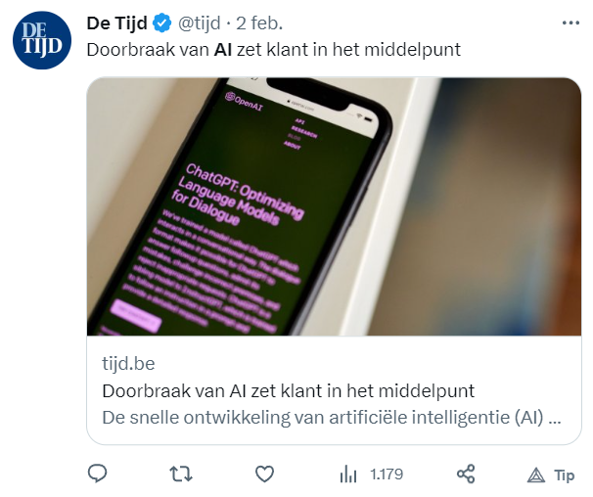
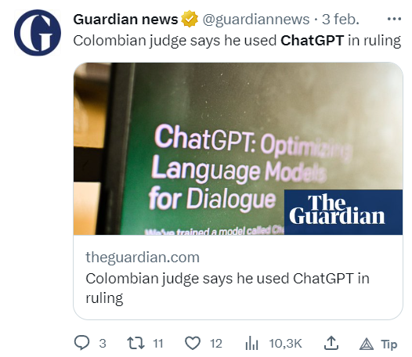
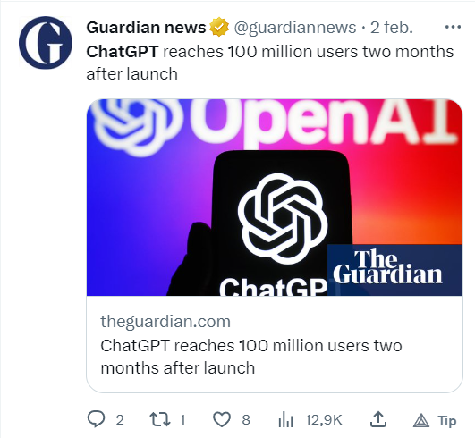
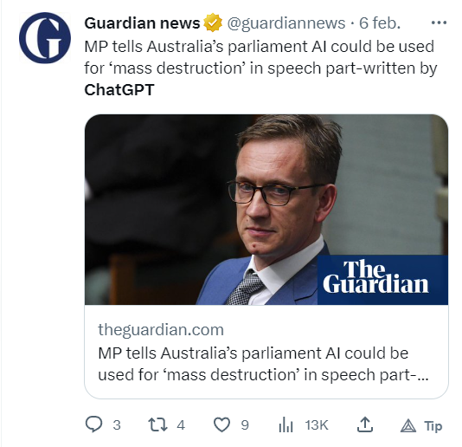

The future of AI is now!

Slide 4

Azure AI Enterprise-ready AI services for your production workloads

Slide 5









AI Portfolio
Applications
Partner Solutions
Business Users
Power Platform
Power BI
Power Apps
Power Automate
Power Virtual Agents
Azure AI
Scenario-Based Services
Applied AI Services
Bot Service
Cognitive Search
Form Recognizer
Video Analyzer
Metrics Advisor
Immersive Reader
Customizable AI Models
Developers
Cognitive Services
Developers & Data Scientists
Vision
Speech
Language
Decision
ML Platform
Azure Machine Learning

Slide 6
Demo time

Slide 7
Applications
Applications
Partner Solutions
Business Users
Power Platform
Power BI
Power Apps
Power Automate
Power Virtual Agents
Azure AI
Scenario-Based Services
Applied AI Services
Bot Service
Cognitive Search
Form Recognizer
Video Analyzer
Metrics Advisor
Immersive Reader
Customizable AI Models
Developers
Cognitive Services
Vision
Speech
Language
Decision
ML Platform
Azure Machine Learning

Slide 8
AI Portfolio
Applications
Partner Solutions
Business Users
Power Platform
Power BI
Power Apps
Power Automate
Power Virtual Agents
Azure AI
Scenario-Based Services
Applied AI Services
Bot Service
Cognitive Search
Form Recognizer
Video Analyzer
Metrics Advisor
Immersive Reader
Customizable AI Models
Developers
Cognitive Services
Vision
Speech
Language
Decision
ML Platform
Azure Machine Learning

Slide 9
AI Portfolio
Applications
Partner Solutions
Business Users
Power Platform
Power BI
Power Apps
Power Automate
Power Virtual Agents
Azure AI
Scenario-Based Services
Applied AI Services
Bot Service
Cognitive Search
Form Recognizer
Video Analyzer
Metrics Advisor
Immersive Reader
Customizable AI Models
Developers
Cognitive Services
Vision
Speech
Language
Decision
ML Platform
Azure Machine Learning

Slide 10
Responsible AI

Slide 11
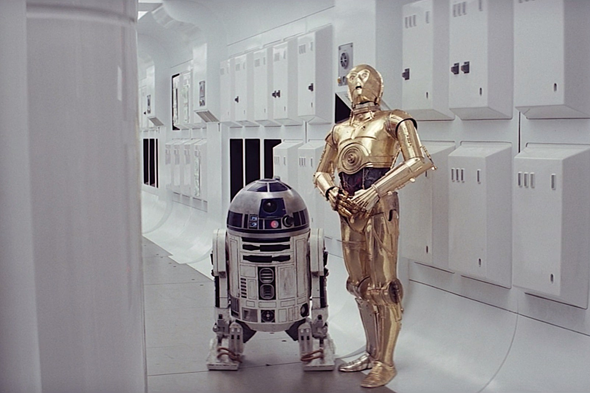
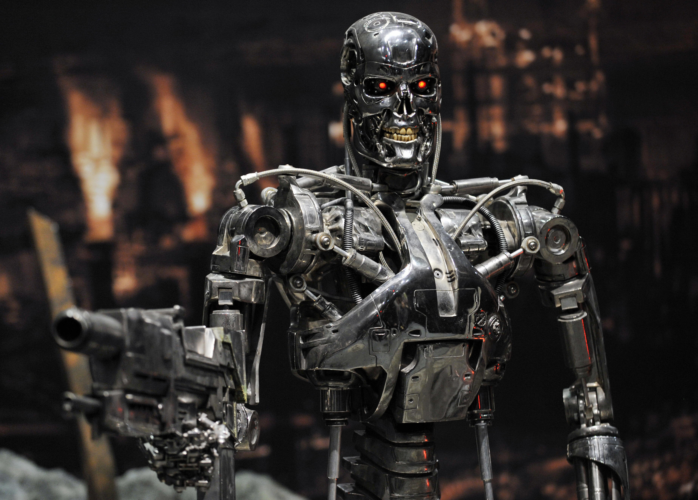
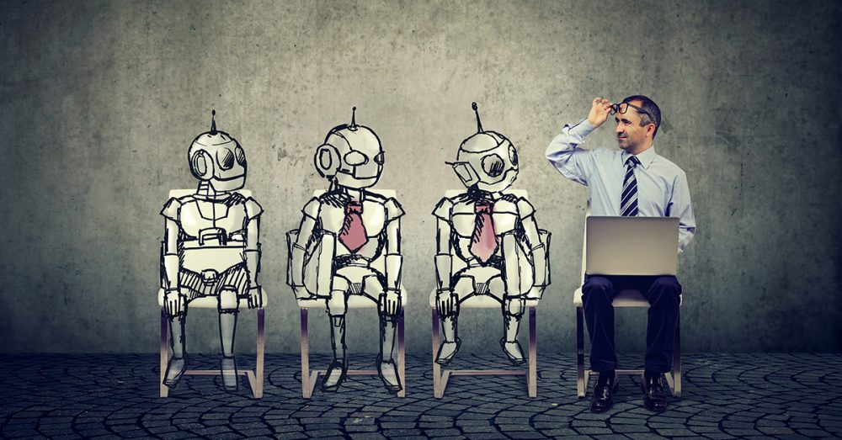
Responsible AI
The Good | The Bad | The Ugly

Slide 12
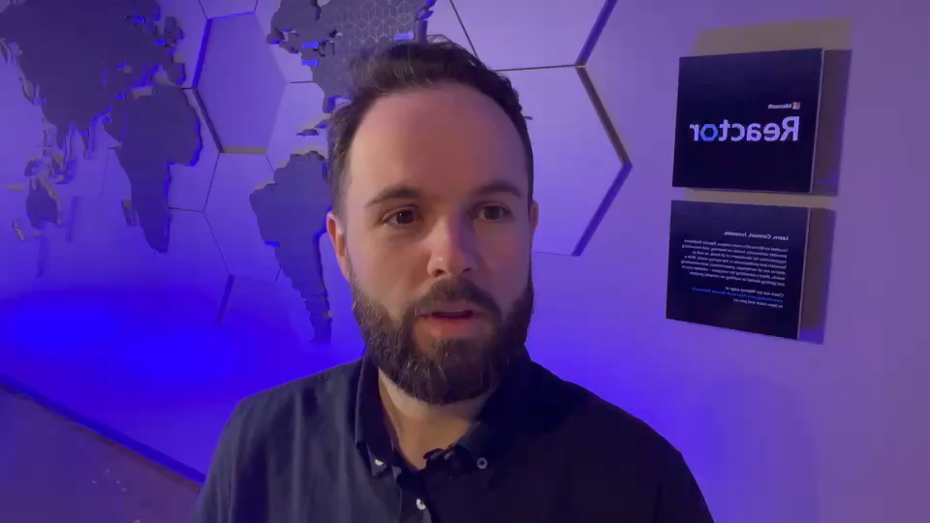
Custom Voice

Slide 13
Questions? Thanks
@arinti.ai
www.arinti.ai
https://github.com/caalspi/cttt23

Slide 14
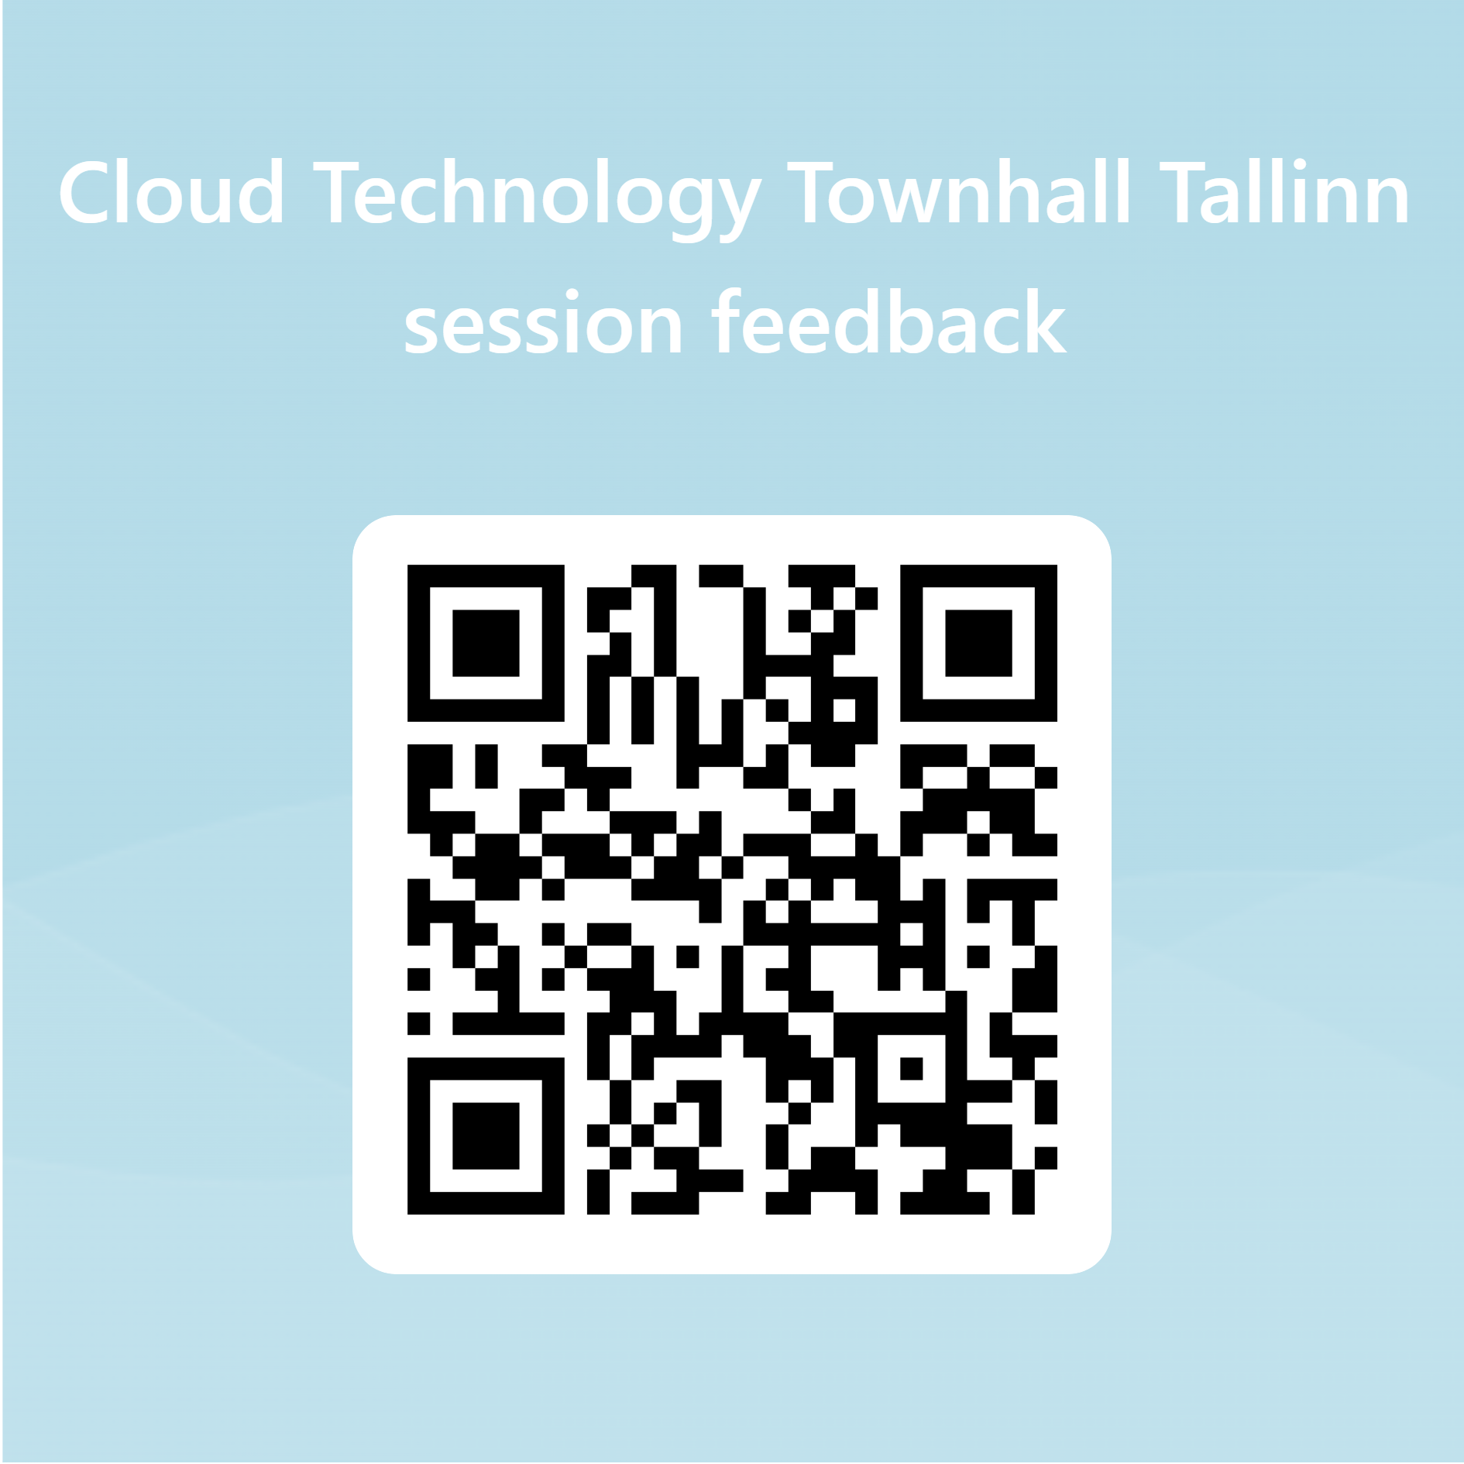
Give us your feedback!

